Slide 1
Module 5 Wireless Network Security
Security in GSM; UMTS Security; Bluetooth Security; WEP; WPA2.
Self-learning Topics :- Study of Wireless Security Tools.

Slide 2
Security in GSM
Security is implemented to prevent unauthorized use of the mobile subscriber number over the air.
The voice conversations need to encrypted using secrecy algorithm in GSM.
Authentication is done with the help of a pre- defined protocol that is used to compare IMSI of MS reliably.
A unique secret key (128 bits) is stored in SIM card.
It uses 3 algorithms
1. A3 – for Authentication (verify users password within SIM)
A5 – for confidentiality (it scramble coded data)
A8 – generate privacy key that used to encrypt voice or data messages.

Slide 3
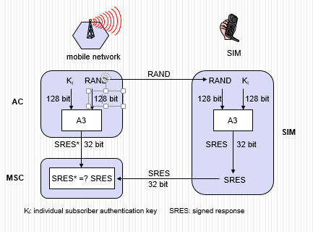
GSM - authentication
Ki is the 128-bit Individual Subscriber Authentication Key utilized as a secret key shared between the Mobile Station and the Home Location Register of the subscriber’s home network.
RAND is 128-bit random challenge generated by the Home Location Register.
SRES is the 32-bit Signed Response generated by the Mobile Station and the Mobile Services Switching Center.

Slide 4
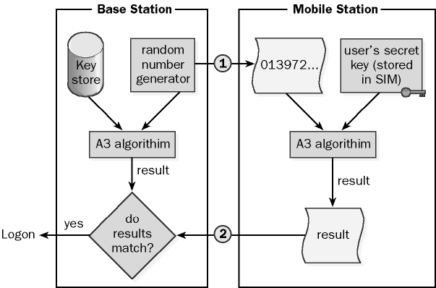
Authentication Process

Slide 5
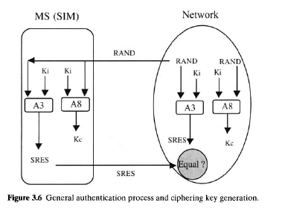
Authentication Process
Kc is the 64-bit ciphering key used as a Session Key for encryption of the over-the-air channel.
Kc is generated by the Mobile Station from the random challenge presented by the GSM network and the Ki from the SIM utilizing the A8 algorithm.

Slide 6
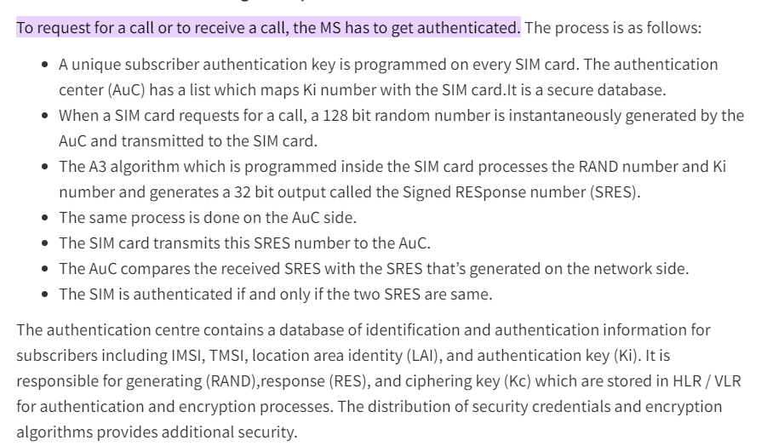

Slide 7
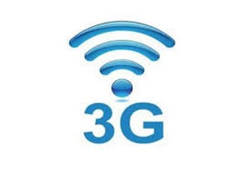
UMTS Security Procedure
UMTS Authentication and Key Agreement (AKA) is a security mechanism used to accomplish the authentication features.
It is based on a challenge/response authentication protocol which is used for a MS to verify the identity of another mobile subscriber without revealing a secret password shared by the two.
The key concept is that each mobile subscriber must prove to the other that it knows the password without actually revealing or transmitting such a password.

Slide 8
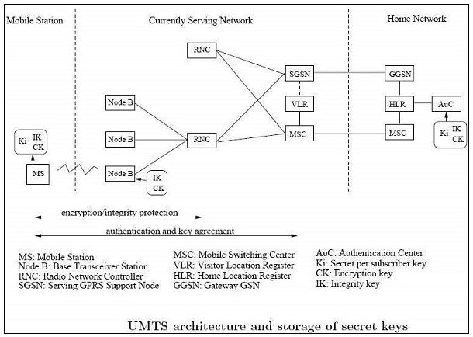

Slide 9
Steps of Authentication and Key Agreement procedure:
Step 1: Visited network's VLR/SGSN requests a set of AVs [authentication vectors] from the HLR/AuC in the mobile subscriber's home network.
Step 2. HLR/AuC computes an array of AVs. This is done by means of the 'authentication algorithms and the mobile subscriber's private secret key K, which is stored only in the home network's HLR/ AuC and the user Identity Module (USIM) in the mobile subscriber's mobile subscriber.
Step 3. Home network's HLR/ AuC responds by sending n authentication vectors back to the visited network's VLR/SGSN.
Step 4. Visited network's VLR/SGSN chooses one AV and challenges the mobile subscriber's USIM by sending the RAND and AUTN fields in the vector to it.
Step 5. The mobile subscriber's USIM processes the AUTN.

Slide 10
Steps of Authentication and Key Agreement procedure: (cont)
With the aid of the private secret key K, the mobile subscriber is able to verify that the received challenge data could only have been constructed by someone who had access to the same secret key K.
The USIM will also verify that the AV has not expired by checking its Sequence Number (SEQ) field
Provided that the network can be authenticated and that the AV is still valid, the USIM proceeds to generate a Confidentiality Key (CK), an Integrity Key (IK) and a Response for the network (RES).
Step 6. The mobile subscriber responds with RES to the visited network.
Step 7. Visited network's VLR/SGSN verifies that response is correct by comparing the Expected Response (XRES) from the current AV with the Response (RES) received from the mobile subscriber's USIM

Slide 11
UMTS Subscriber to UMTS Network
Both the network and the mobile station supports all the security mechanisms of UMTS.
Authentication and Key agreement is as follows −
The mobile station and the base station to establish a radio resource control connection (RRC connection). During the establishment of the connection the mobile station sends its security capabilities to the base station. Security features include UMTS integrity and encryption algorithms supported and possibly GSM encryption capabilities as well.
The mobile station sends its temporary identity TMSI current on the network.
If the network cannot solve the TMSI, he asks the mobile station to send its permanent identity and the mobile stations responding to the request with the IMSI.
The visited network requests authentication of the home network of the mobile station data.
The home network returns a random challenge RAND, the corresponding authentication token AUTN, authentication
Response XRES, integrity key IK and the encryption key CK.
The visited network sends RAND authentication challenge and authentication token AUTN to the mobile Station.

Slide 12
The mobile station checks AUTN and calculates the authentication response. If AUTN is corrected.
The mobile station sends its authentication response RES to the visited network.
Mobile station ignores the message.
Visiting the network checks if RES = XRES and decide which security algorithms radio subsystem is allowed to use.
The visited network sends algorithms admitted to the radio subsystem.
The radio access network decides permit (s) algorithms to use.
The radio access network informs the mobile station of their choice in the security mode command message.
The message also includes the network security features received from the mobile station in step 1.
This message is integrity protected with the integrity key IK.
The mobile station confirms the protection of the integrity and verify the accuracy of the safety functions.

Slide 13
UMTS Subscriber to GSM Base Station
The mobile unit (subscriber UMTS) supports both USIM and SIM application.
The base station system uses GSM while the VLR / MSC technology components are respectively the UMTS SGSN.
The mobile station and the core network both support all security mechanisms of UMTS.
However, the base station system GSM (BSS) does not support the protection of the integrity and uses the GSM encryption algorithms.
The first eight steps of the authentication protocol are performed as in the classical case. GSM BSS simply forwards the UMTS authentication traffic.

Slide 14
The MSC / SGSN decides which GSM encryption algorithms are allowed and calculates the key GSM Kc UMTS keys IK, CK.
The MSC / SGSN advises the GSM BSS authorized algorithms and transmits the GSM cipher key Kc.
GSM BSS decide which encryption algorithms allowed to use based encryption capabilities of the mobile station.
GSM BSS sends the GSM cipher mode command to the station.

Slide 15

Bluetooth Security

Slide 16
Bluetooth security supports authentication and encryption.
These features are based on a secret link key that is shared by pair of devices.
A pairing procedure is used when two devices communicate for the first time to generate this key.
There are three security modes to a device:
1.Non-secure: A device will not initiate any security procedure.

Slide 17
2.Service level enforced security.
A device does not initiate security procedures before channel establishment at the L2CAP level.
This mode allows different and flexible access policies for applications, especially running applications with different security requirements in parallel.
3.Link level enforced security.
A device initiates security procedures before the link set-up at the LMP is completed.

Slide 18
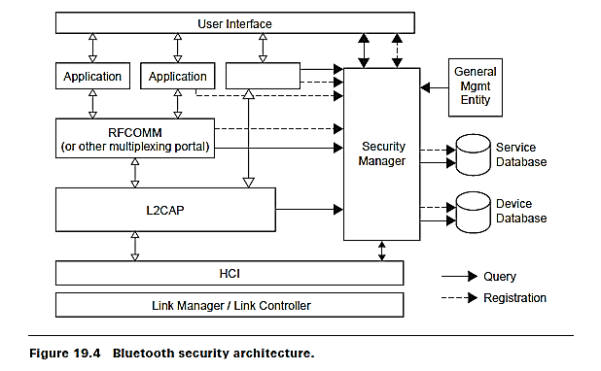
Security Levels
There are two kinds of security levels:
authentication
authorization

Slide 19
Authentication verifies who is at the other end of the link.
In Bluetooth this is achieved by the authentication procedure based on the stored link key or by the pairing procedure.
To meet different requirements on availability of services without user intervention, authentication is performed after determining what the security level of the requested service is.
Authentication cannot be performed when the ACL link is established.
The authentication is performed when a connection request to a service is submitted.
Authentication can be performed in both directions: client authenticates server and vice versa.

Slide 20
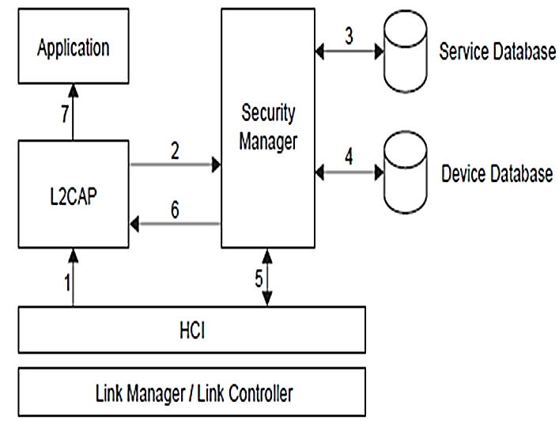
The following procedure is used
1. The connect request to L2CAP is sent.
2. L2CAP requests access from the security manager.
3. The security manager enquires the service database.
4. The security manager enquires the device database.
5. If necessary, the security manager enforces the authentication and encryption procedure.
6. The security manager grants access, and L2CAP continues to set up the connection.

Slide 21
Authorization. When one device is allowed to access the other, the concept of trust comes into existence.
Trusted devices are allowed access to services.
Untrusted devices may require authorization based on user interaction before access to services is granted.
There are two kinds of device trust levels:
Trusted device
Untrusted device

Slide 22
Trusted device: A device with a fixed relationship (paired) that has trusted and unrestricted access to all services.
2. Untrusted device: This device has been previously authenticated, a link key is stored, but the device is not marked as trusted in the device database.
An unknown device is also an untrusted device. No security information is available for this device.
For services, the requirement for authorization, authentication, and encryption are set independently.

Slide 23
The access requirements define three security levels:
1-Services that require authorization and authentication— automatic access is only granted to trusted devices. Other devices need a manual authorization.
2-Services that require authentication only — authorization is not necessary.
3-Services open to all devices — authentication is not required, no access approval is required before service access is granted

Slide 24
Limitations of Bluetooth Security
Only a device is authenticated, and not its user.
There is no mechanism to preset authorization per service.
a more flexible security policy can be implemented with the present architecture without a need to change the Bluetooth protocol stack.
it is not possible to enforce unidirectional traffic.

Slide 25
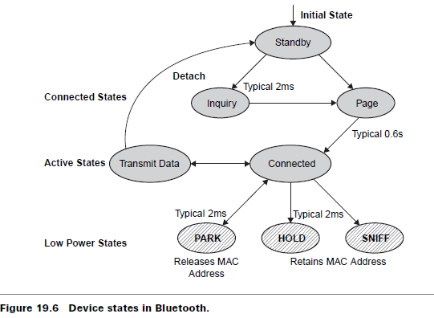
Network Connection Establishment in Bluetooth

Slide 26
Network Connection Establishment in Bluetooth
Before any connection in a piconet is created, all devices are in STANDBY mode.
In this mode, an unconnected unit periodically listens for messages every 1.28 seconds.
Each time a device wakes up, it listens on a set of 32 hop frequencies defined for that unit.
The number of hop frequencies varies in different geographic regions.

Slide 27
The connection procedure is initiated by any one of the devices, which then becomes master.
A connection is made by a PAGE message if the address is already known, or by an INQUIRY message followed by a subsequent PAGE message if the address is unknown.
In the initial PAGE state, the master unit sends a train of 16 identical page messages on 16 different hop frequencies defined for the device to be paged (slave unit).

Slide 28
If no response is received, the master transmits a train on the remaining 16 hop frequencies in the wake-up sequence.
The maximum delay before the master reaches the slave is twice the wake-up period (2.56 seconds)
while the average delay is half the wake-up period (0.64 seconds).

Slide 29
The INQUIRY message is typically used for finding Bluetooth devices, including public printers, fax machines, and similar devices with an unknown address.
The INQUIRY message is similar to the PAGE message, but may require one additional train period to collect all responses.
A power saving mode can be used for connected units in a piconet if no data needs to be transmitted.
The master unit can put slave units into HOLD mode, where only the internal timer is running.

Slide 30
Slave units can also demand to be put into HOLD mode.
Data transfer restarts instantly when units transition out of HOLD mode.
The HOLD is used when connecting several piconets or managing a low-power device such as a temperature sensor.
Two more low-power modes are also available: the SNIFF mode and PARK mode.
In the SNIFF mode, a slave device listens to the piconet at a reduced rate, thus reducing its duty cycle.
The SNIFF interval is programmable and depends on the application.

Slide 31
In the PARK mode, a device is still synchronized to the piconet but does not participate in the traffic.
Parked devices have given up their MAC address and occasionally listen to the traffic of the master to resynchronize and check on broadcast messages
If the modes are listed in increasing order of power efficiency, then
SNIFF mode has the higher duty cycle,
Followed by the HOLD mode with a lower duty cycle,
PARK mode with the lowest duty cycle.

Slide 32
Error Correction in Bluetooth
Three error correction schemes are defined for the Bluetooth baseband controller:
1/3 rate forward error correction (FEC) code
2/3 rate forward error correction code
Automatic repeat request (ARQ) scheme for data
The purpose of the FEC scheme on the data payload is to reduce the number of retransmissions.
in a reasonably error-free environment, FEC creates unnecessary overhead that reduces the throughput

Slide 33
Network Topology in Bluetooth
Bluetooth devices can create both point-to-point and point-to-multipoint connections.
A connection with two or several (maximum 8 devices) devices is a piconet where all devices follow the same frequency-hop scheme.
To avoid interference between devices, one of the devices automatically becomes a master of the piconet.

Slide 34
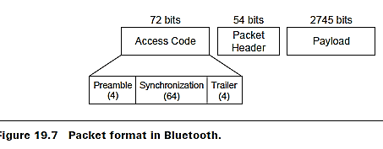
In each slot, a packet can be exchanged between the master (M) and one of the slaves (S).
Packets have a fixed format (see Figure )

Slide 35
A Bluetooth packet format is based on one packet per hop and a basic 1-slot packet of 625µs that can be extended to 3-slot (1875µs) and 5-slot (3125µs).
A frame format allows the master to poll multiple slaves.
Each packet begins with a 72-bit access code that is derived from the master identity and is unique for the channel.
Every packet exchanged on the channel is preceded by this access code

Slide 36
Recipients on the piconet compare incoming signals with the access code.
If the two do not match, the received packet is not considered valid on the channel and the rest of its contents are ignored.
Besides packet identification, the access code is also used for synchronization and compensating for offset.
The access code is robust and resistant to interference.
Two or several piconets can communicate with each other and are then called a scatternet.

Slide 37
Bluetooth Usage Models
Each usage model has one or more profiles.
Three-in-one phone: The three-in-one phone usage model describes how a telephone handset may connect to three different service providers.
The telephone may act as a cordless telephone connecting to the PSTN at home, charged at a fixed line charge.

Slide 38
The telephone can also connect directly to other telephones acting as a walkie-talkie or handset extension.
the telephone may act as a cellular phone connecting to the cellular infra structure.
File transfer: The file transfer usage model offers the capability to transfer data objects from one Bluetooth device to another.
Files, entire folders, directories, and streaming media formats are supported in this model

Slide 39
Synchronization: The synchronization usage model provides the means for automatic synchronization between, a desktop PC, a portable PC, a PDA, and a notebook.
The synchronization requires business card, calendar, and task information to be transferred and processed by computers, cellular phones, and PDAs utilizing a common protocol and format.

Slide 40
Internet bridge: The Internet bridge usage model describes how a mobile phone or cordless modem provides a PC with dial-up networking capabilities without the need for physical connection to the PC.
This networking scenario requires a two-piece protocol stack, one for AT-commands to control the mobile phone and another stack to transfer payload data.

Slide 41
Ultimate handset: The ultimate handset usage model defines how a Bluetooth Equipped wireless handset can be connected to act as a remote unit’s audio input and output interface.
This unit is probably a mobile phone or a PC for Audio input and output.

Slide 42
Bluetooth Applications
The following are some of the areas where Bluetooth can be used:
Replacing serial cables with radio links
Wearable networks/WPANs
Desktop/room wireless networking
Hot-spot wireless networking
Medical: Transfer of measured values from training units to analytical systems, patient monitoring
Automotive: Remote control of audio/video equipment, hands-free telephony
Point-of-sale payments: Payments by mobile phone

Slide 43
Wireless Application Protocol (WAP) and Bluetooth
Bluetooth can be used with WAP like any other wireless network.
Bluetooth wireless networks can be used to transport data from a WAP client to a WAP server.
The WAP client can make use of Bluetooth’s Service Discovery Protocol(SDP) to find the WAP server/ gateway.
when the WAP device is a mobile phone and when it comes into the range of a WAP server, it can use Bluetooth’s SDP to discover the gateway.

Slide 44
The Bluetooth SDP must be able to provide some details about the WAP server to the WAP client.
The other feature that can be supported is the reverse of the above.
The WAP server can periodically check for the availability of WAP-enabled clients in its range. It can use Bluetooth’s SDP to do this.
If there are any clients, the server can push any data to the client.
The client of course is not required to accept the data pushed to it.

Slide 45
Summary
Bluetooth technology allows for replacing many proprietary cables that connect one device to another with one universal short range radio link.
Bluetooth radio technology provides a universal bridge to existing data networks, a peripheral interface, and a mechanism to form small, private ad hoc groupings of connected devices away from fixed network infrastructures.

Slide 46
The Bluetooth technology has a number of advantages including minimal hardware dimensions, low cost of components, and low power consumption.
These advantages make it possible to introduce Bluetooth in many types of devices at a low cost.
The 720 kbps data capability provided by Bluetooth can be used for cable replacement and several other applications, such as LAN.

